Slide 1
Fundamentals of population genomics
Reid Brennan & Jenny Nascimento-Schulze
rbrennan@geomar.de

Slide 2
Goals of course
Basics of population and quantitative genetic theory
Gain understanding of the technologies and data underlying genomics
Experience using the command line and R to analyze data
Ability to analyze and interpret population genetics data

Slide 3
Course format
Lectures introducing fundamentals
Mostly short lectures
Hands on tutorial
→ analyzing population genomic dataset together
Independent project
In groups, analyze population genomic data and present results via poster

Slide 4
Independent project
In groups of 2-3
From VCF, analyze data to make population genetic inferences
Poster on July 4
Grading:
Use of tools covered in the course
Appropriate conclusions from your results
Overall quality of analysis, interpretation, and presentation
You must hand in:
1. Poster
2. mark down/html document of your analysis.

Slide 5
Schedule
Day 1-5: Tutorial
Day 6-10: Project
For the most up to date information, slides, tutorials, see the course website:
https://rsbrennan.github.io/EvolutionaryGenomics_2024/

Slide 6
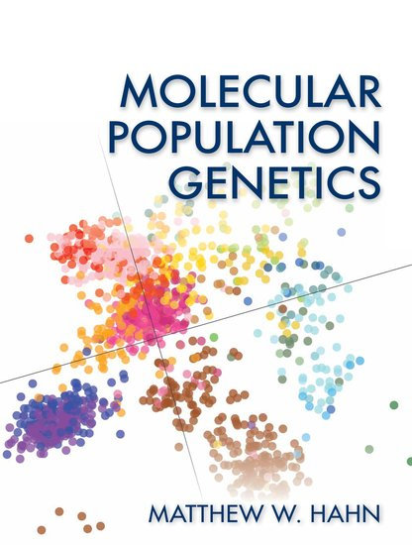
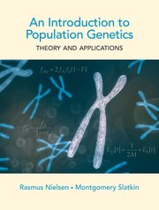
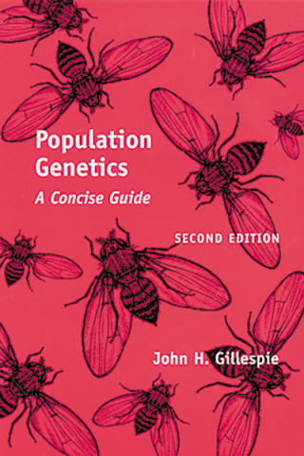
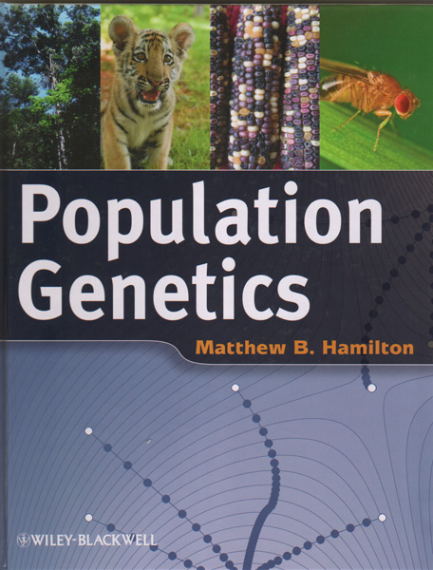
Resources
Graham Coop’s Population and Quantative Genetics notes
https://github.com/cooplab/popgen-notes/releases
And many others….

Slide 7
What is genomics anyway?

Slide 8
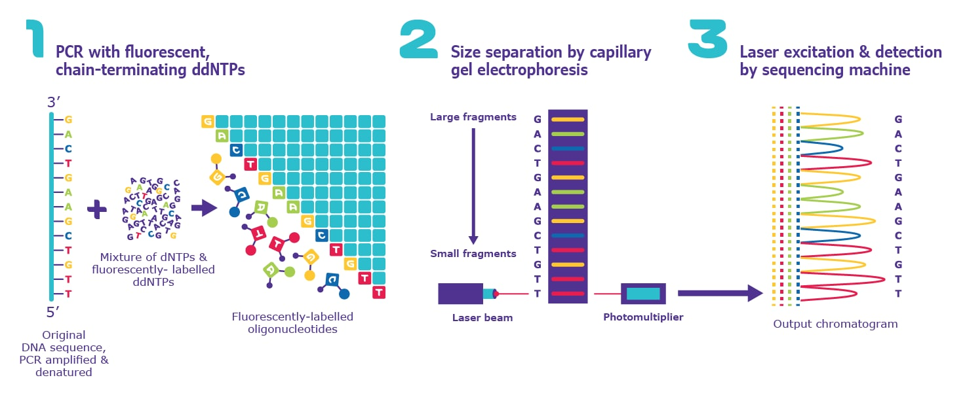
Sanger sequencing
A few hundred to ~1000 bp
Low throughput
Accurate
https://www.sigmaaldrich.com/DE/de/technical-documents/protocol/genomics/sequencing/sanger-sequencing

Slide 9
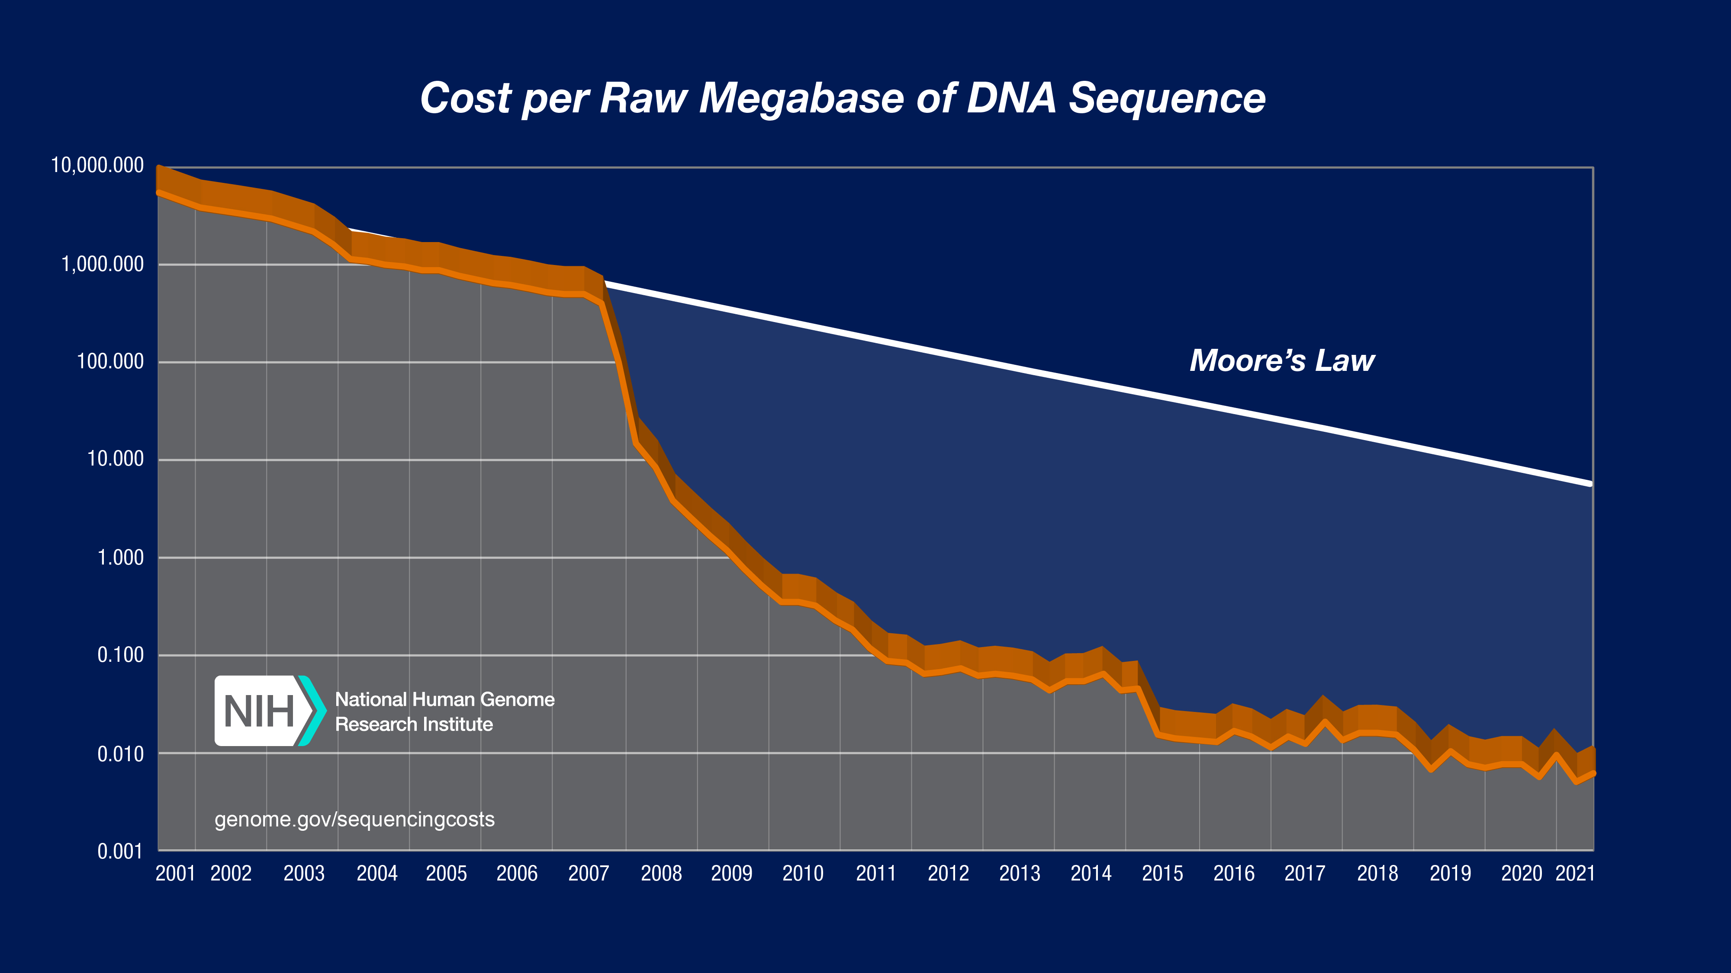
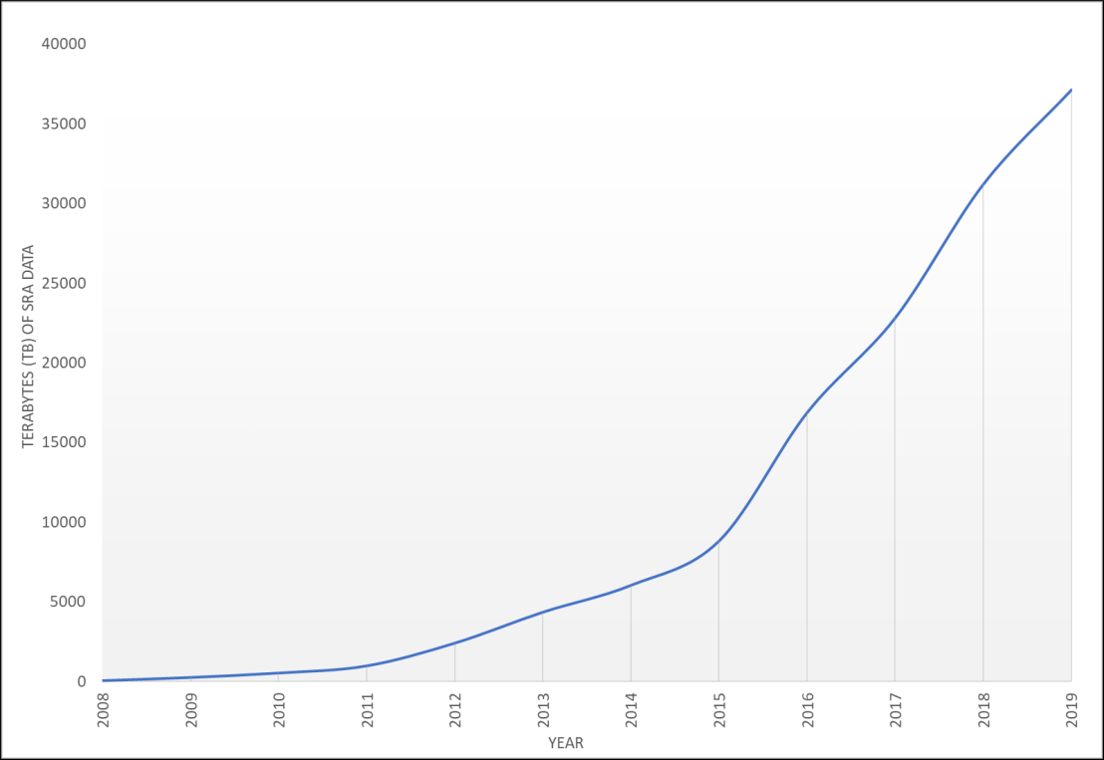
Data in NCBI
Notes:
moore's law- computing power should double every 2 years.

Slide 10
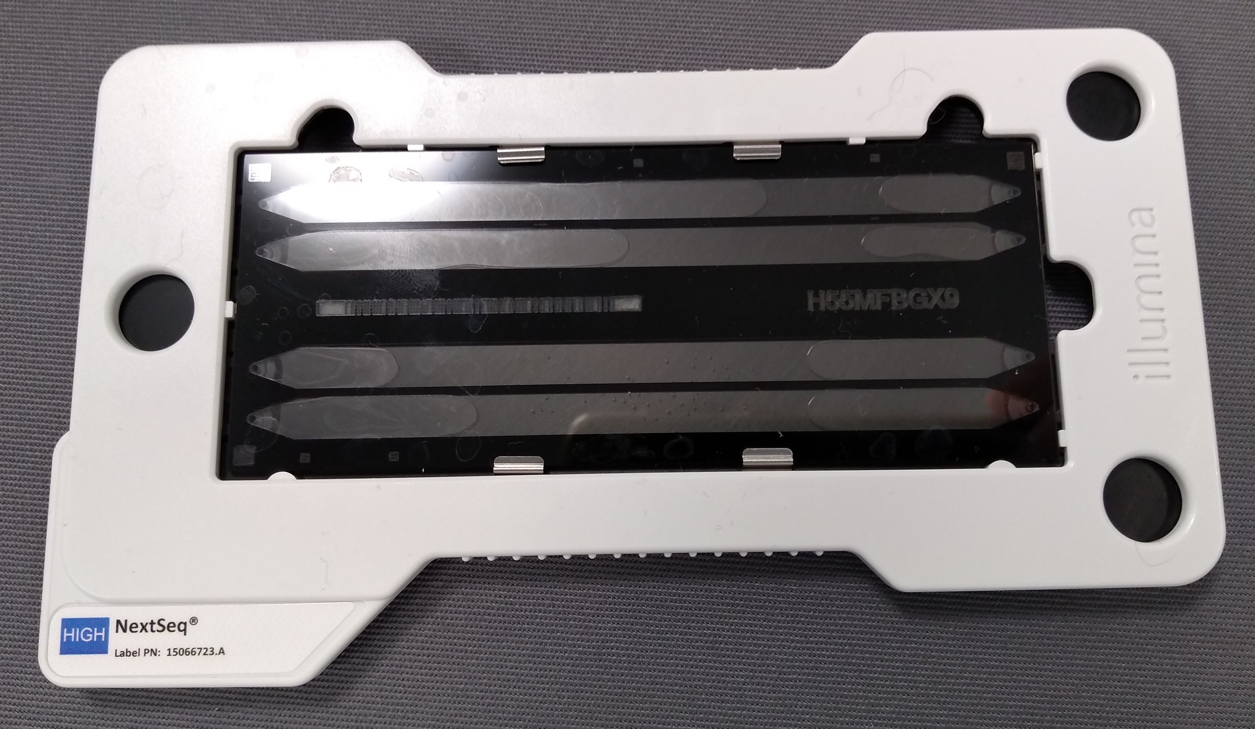
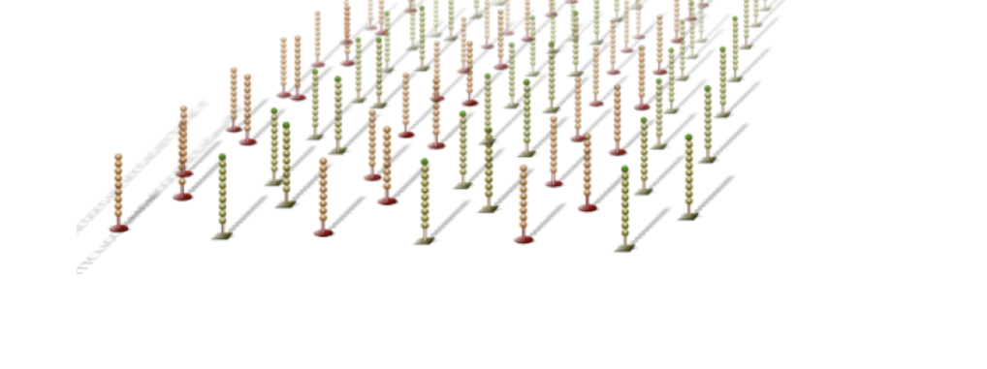
Massively parallel sequencing
Illumina flow cell
Aka
Next generation sequencing
Second generation sequencing
Dominated by Illumina currently
Short reads
50-150 bp
Very high throughput
http://en.biomarker.com.cn/platforms/illumina

Slide 11
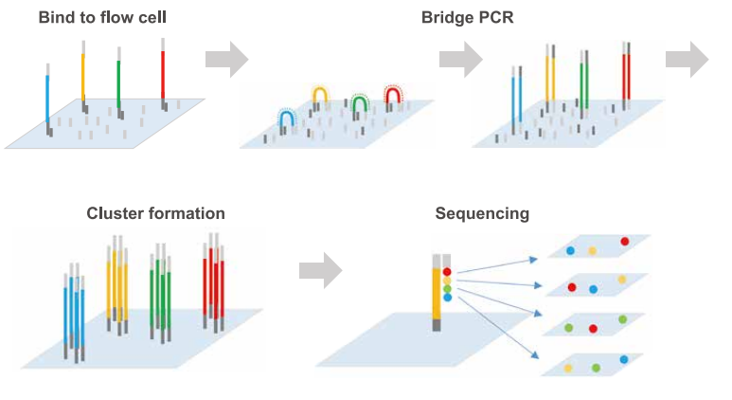
Fragment your DNA
Read 2 Primer
Read 1 Primer
P5
Sample DNA
Barcode
P7
Add adapters and amplify
Sequencing by
synthesis
https://www.genscript.com/advancing-genomics-medicine-and-health-together-by-semiconductor-dna-synthesis-technology-summary.html
Notes:
One base added at a time. They have a reversible blocker, that only allows one to be added.
Bridge amplification:
as a way to amplify the signal that you get from a single fluorescent molecule so that you get enough signal to easily detect it with a microscopy system.
Limits errors

Slide 12
Some important concepts to understand
Library
The prepared sequences ready for sequencing that represent your sample
We modify the DNA to make a sequencing library
Read
One sequence from a library
Forward /Read 1
Read 2 Primer
Read 1 Primer
P5
Sample DNA
Barcode
P7
Reverse /Read 2

Slide 13
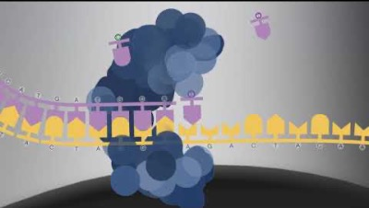
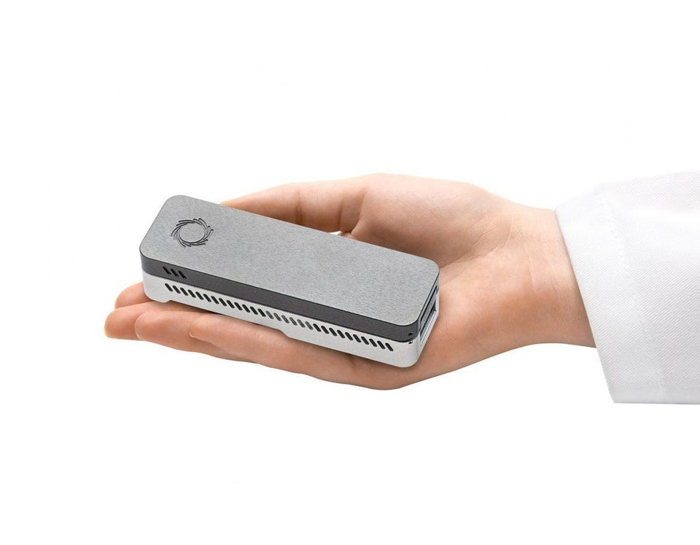
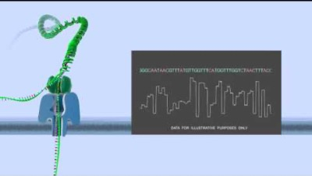
Long read technologies
PacBio
10-50kb read length
Medium output
Read length limited by the longevity of the polymerase.
Oxford Nanopore
100kb or more
Low output
Read length limited by the length of the input DNA and decreasing yield with increasing DNA length
https://www.youtube.com/watch?v=_lD8JyAbwEo
https://www.youtube.com/watch?v=E9-Rm5AoZGw

Slide 14
Illumina
150-300bp read length
High output
PacBio
10-25kb read length
Medium output
Nanopore
100kb or more
Low output
Population genetics, SNPS, RNAseq
Structural variation, genome assembly
Structural variation, genome assembly, in field analysis
What would we use each technology for?

Slide 15
To study population genetics, we need to know allele frequencies → genomics!

Slide 16
Study system for the practical

Slide 17
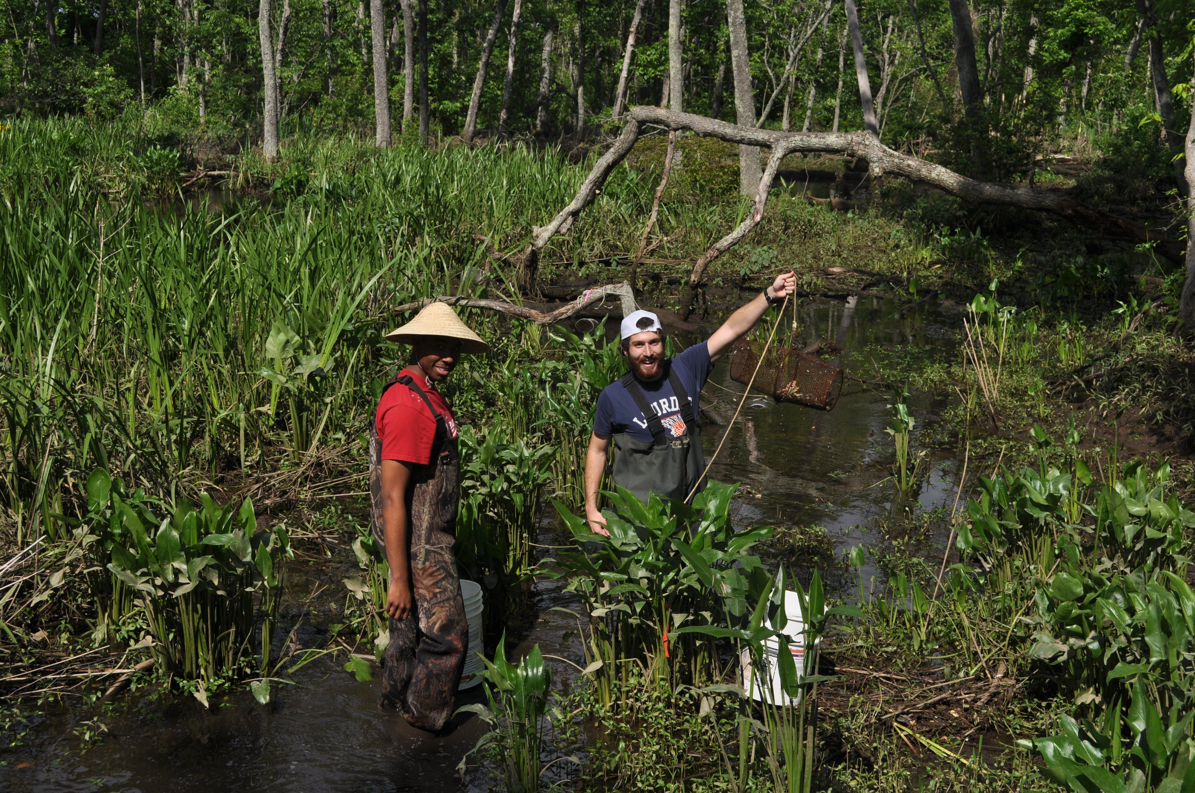
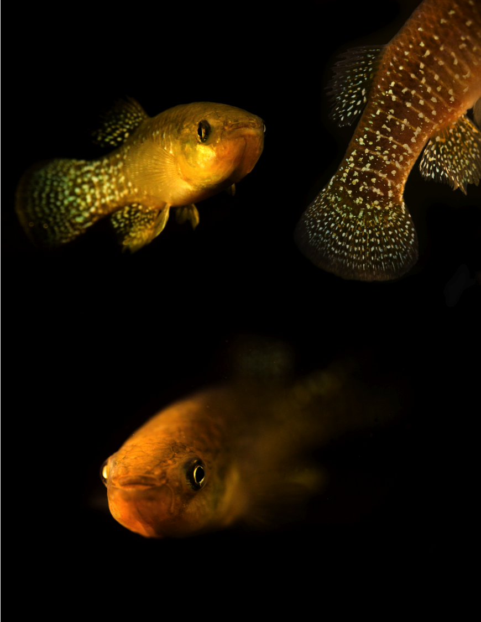
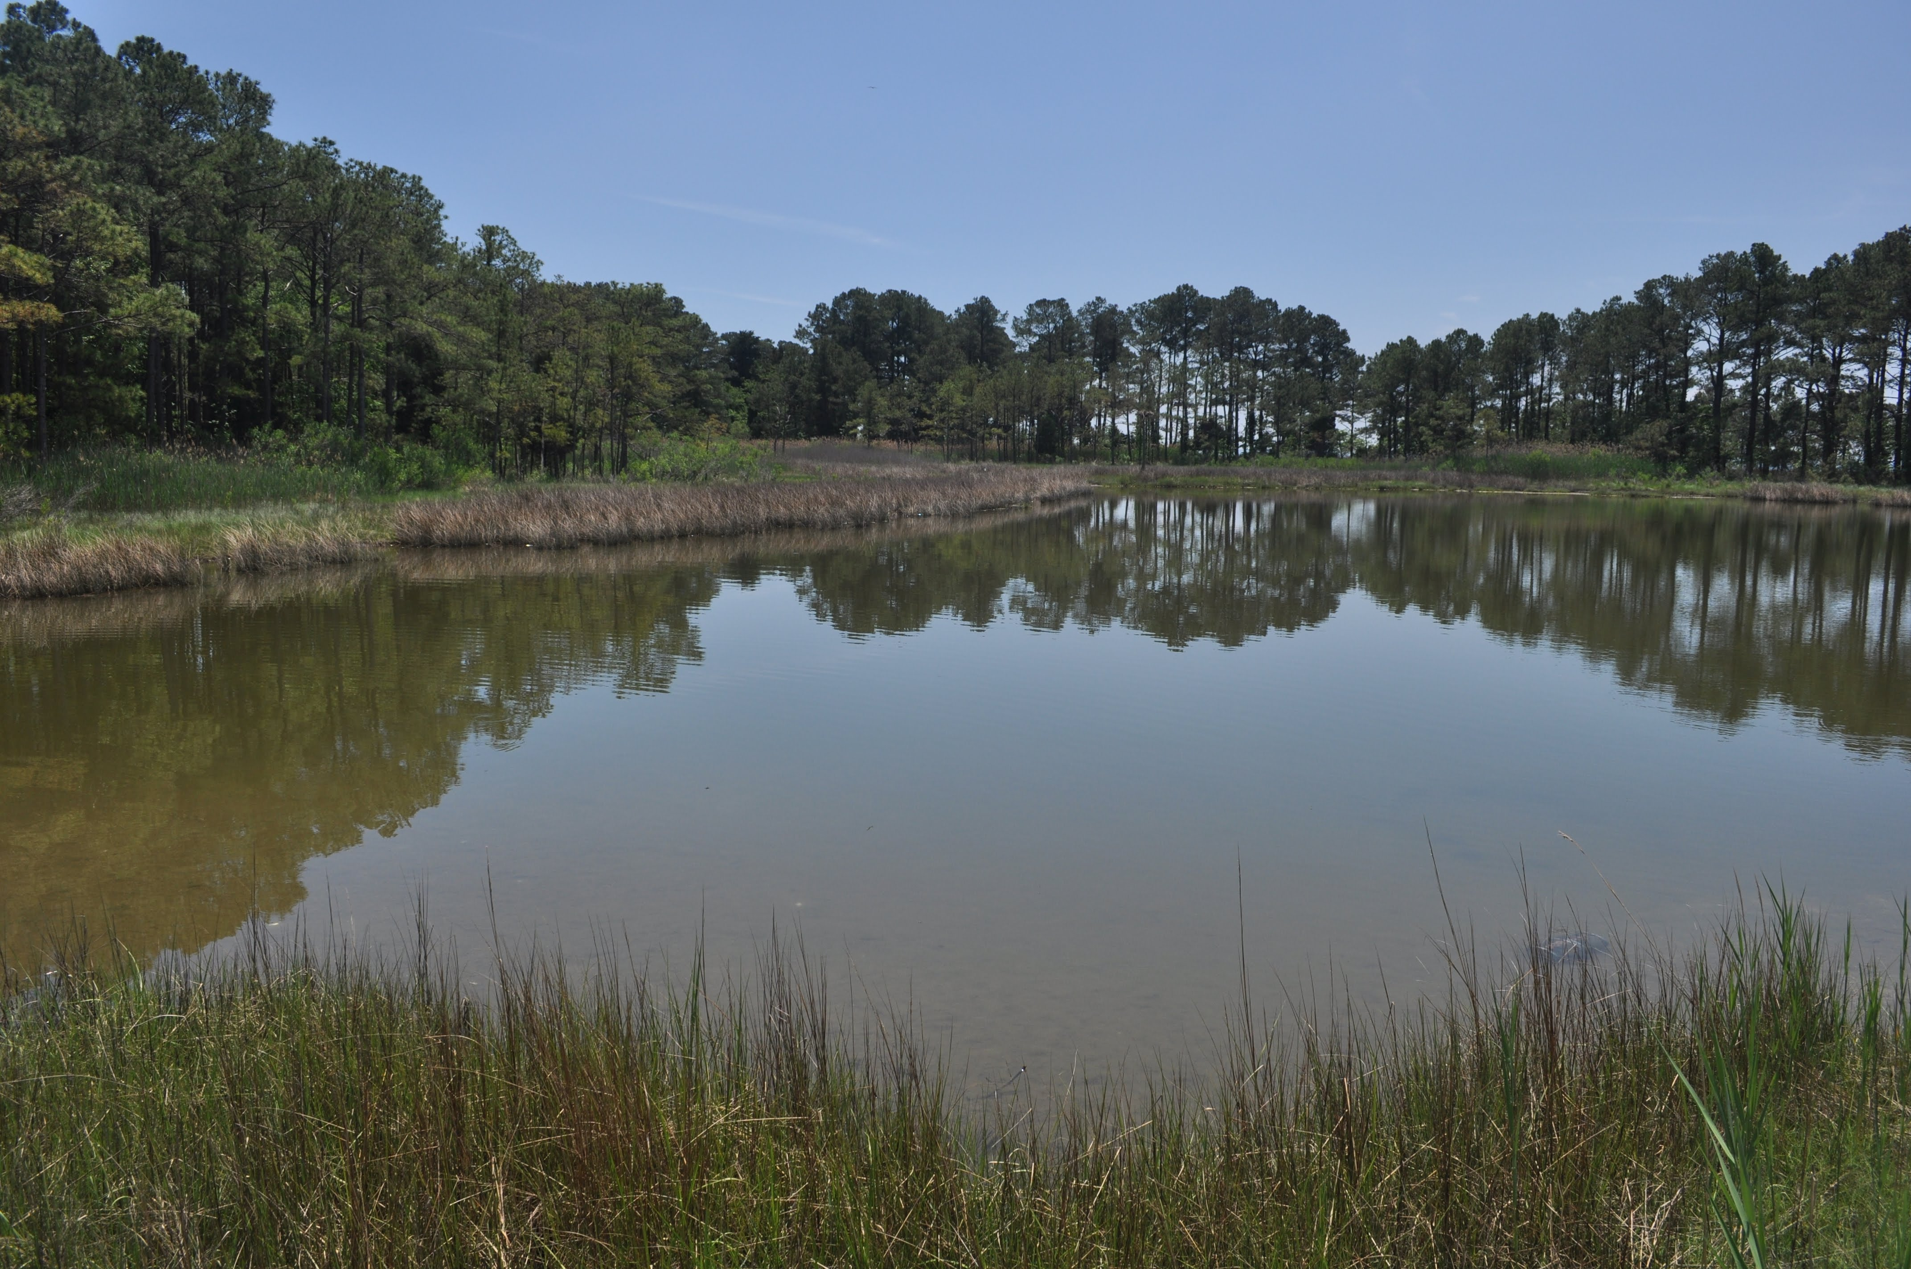
Fundulus heteroclitus study system

Slide 18
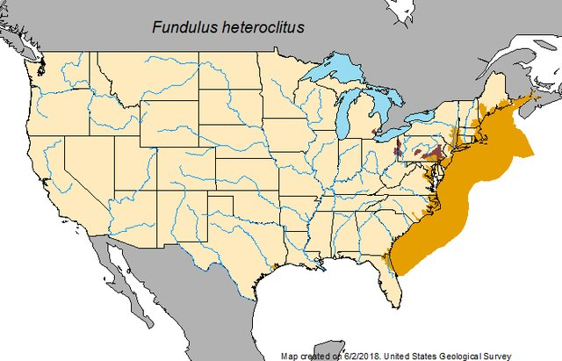
Fundulus heteroclitus study system
Large population sizes
Low movement
Huge range of environments
Temperature
Salinity
Hypoxia
Given the high population sizes and low migration:
what might we predict about populations of killifish from different regions of their distribution?
Alcaraz-Hernandez and Garcia-Berthou

Slide 19
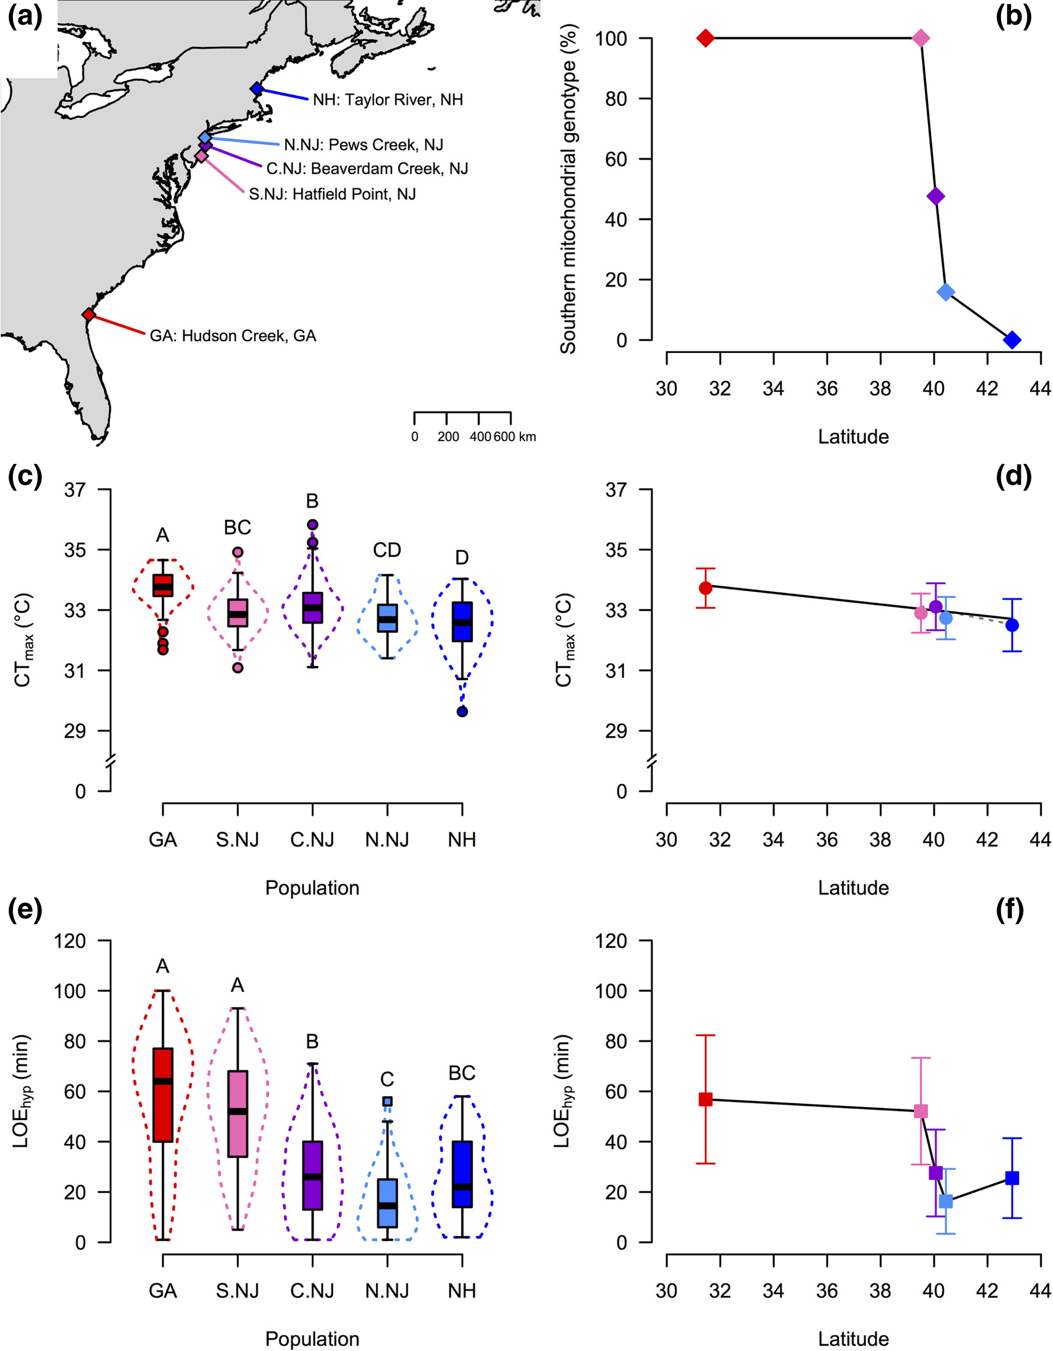
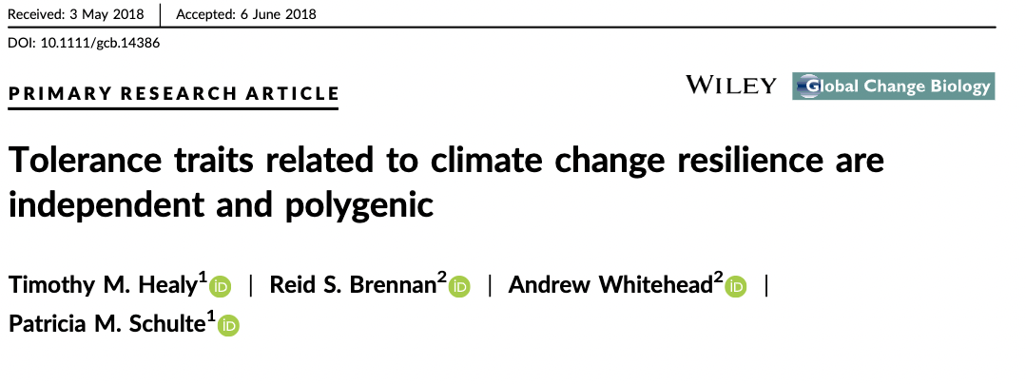

Slide 21
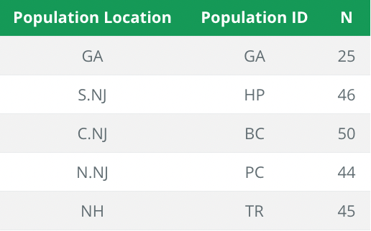
Dataset
RAD-seq

Slide 22
Dataset
Population structure
Genetic diversity
Selection

Slide 23
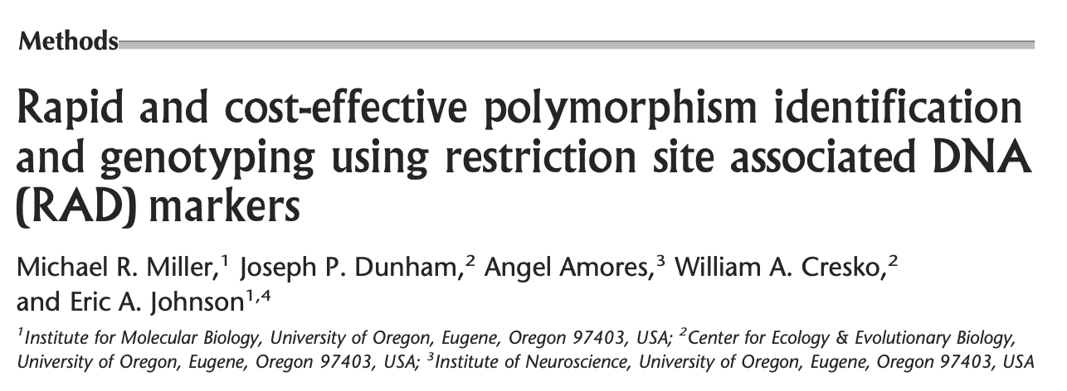
Reduced representation
In an ideal world…
Sequence full genomes of all individuals from many populations
Expensive, sometimes unnecessary, limited genomic resources
RADseq, GBS, sequence capture, ddRAD, 2b-RAD…
Useful for population structure and similar
But… misses lots of the genome
Cut anywhere you see the restriction site:
CCTGCAGG
2007

Slide 24
Reduced representation
5’ CCTGCAGG 3’
3’ GGACGTCC 3’
5’ CCTGCA|GG 3’
3’ GG|ACGTCC 3’
GG……..
ACGTCC………
In an ideal world…
Sequence full genomes of all individuals from many populations
Expensive, sometimes unnecessary, limited genomic resources
RADseq, GBS, sequence capture, ddRAD, 2b-RAD…
Useful for population structure and similar
But… misses lots of the genome
Cut anywhere you see the restriction site:
CCTGCAGG
Ligate adapters for sequencing

Slide 25
How much of the genome does RADseq cover?
How big is the genome?
1.5 billion bases
How often do we find a cut site?
Assume bases are randomly distributed
0.25^8
1.5e+09*(0.25^8) = 22,888

Slide 26
Unix, cloudlab, and R

Slide 27
We have lots of data
Normal to get back 100’s of GB of data.
You can’t have this on your computer!
Computer clusters are needed
These require command line, unix, etc.

Slide 28
Why unix/command line?
Most software is written for unix
Computing clusters use unix
Good at working with large data
Why R?
Very popular in biology (good community)
Good for statistics
Good for plotting
Why Both?
Reproducible!!

Slide 29
How to learn?
By trying
Workshops/courses
Google
Stackoverflow; seqanswers; others
ChatGPT

Slide 30



“the cloud”
Aka, a computer somewhere else
We will use Cloudlab → hosted by CAU

Slide 31
R Markdown
You want to have a record of you analyses → markdown
plain text formatting syntax designed to be converted to HTML and others
R markdown is an extended markdown, that can embed and run R code, generate plots, etc.
Why?
Reproducibility
You will turn in a R markdown file with your final project

Slide 32
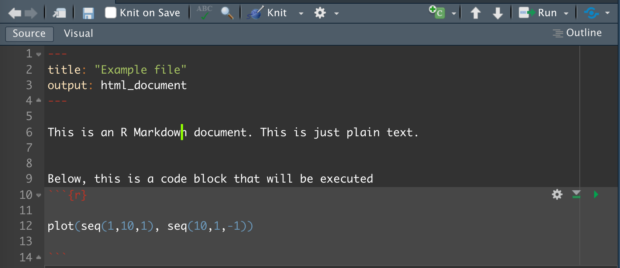
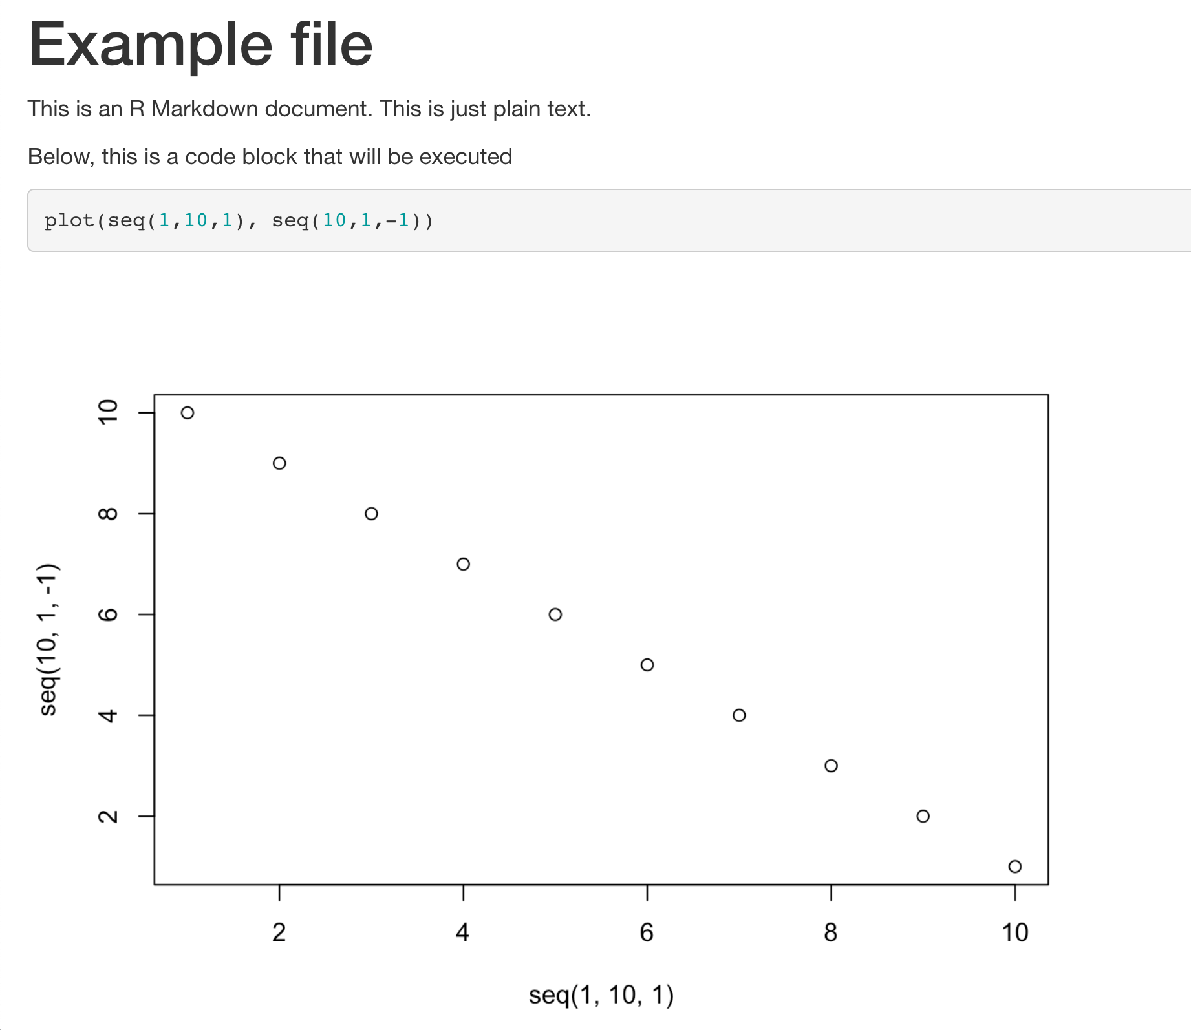
metadata
text
code chunks

Slide 33
Today’s tutorial
Go to cloudlab together.
Start exploring Rmarkdown
Unix for biologists

